Slide 1
Mainstream: Dynamic Stem-Sharing for Multi-Tenant Video Processing
Angela Jiang, Daniel L.-K. Wong, Christopher Canel,
Lilia Tang, Ishan Misra, Michael Kaminsky,
Michael Kozuch, Padmanabhan Pillai,
David G. Andersen, Greg Ganger

Slide 2
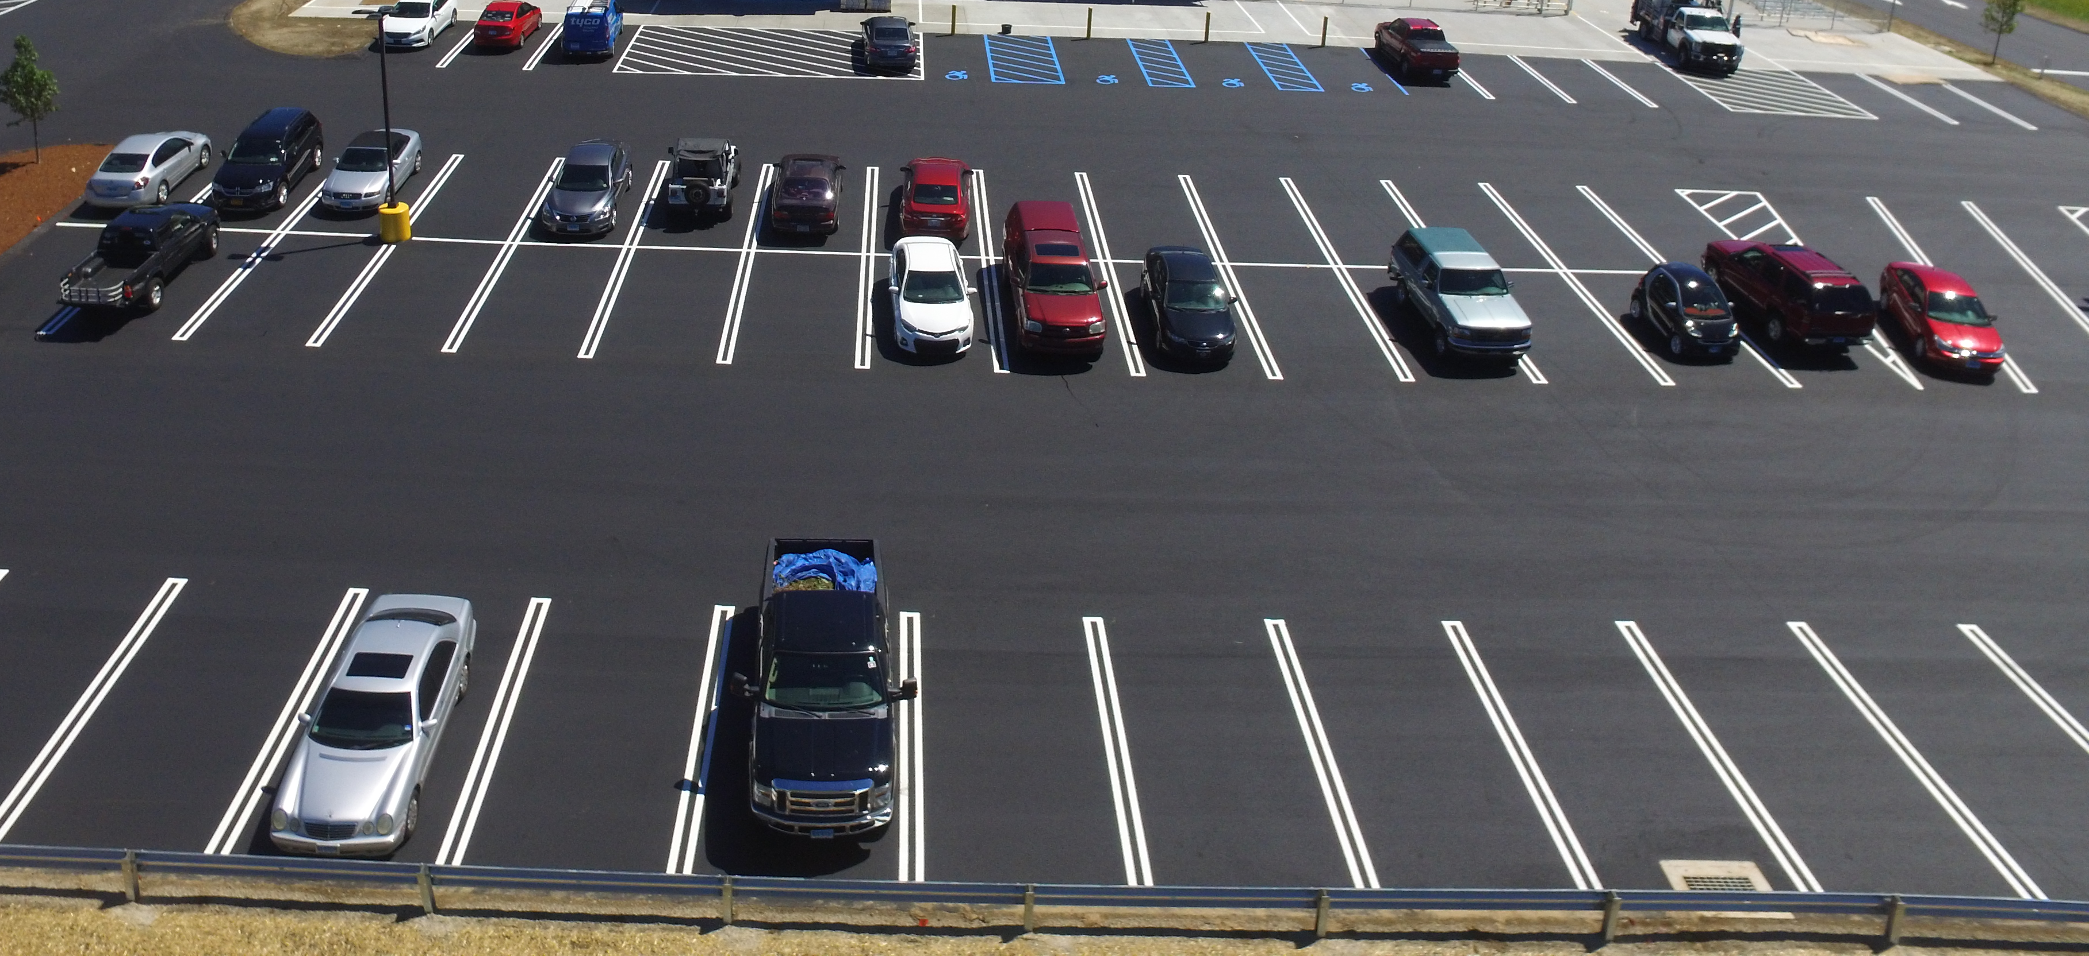
parking violation monitor
parking spot finder
fender-bender monitor
white
Camry
detector
Notes:
Imagine that you have a camera, generating a video stream of the parking lot. And this camera is attached to some edge compute resources. You can imagine that there are a lot ways you’d want to use these edge resources to analyze the video stream in real time

Slide 3
Mainstream challenges and solutions
!
Concurrent DNN inference is slow
✓
Mainstream shares redundant computation
!
Deployed apps are tuned in isolation and offline
✓
Mainstream dynamically tunes DNNs at runtime
Notes:
Usually transfer learned, and usually transfer learned using same base application
But network is trained independently (nobody ever remembers that they’re off the same base, we think there’s an opportunity there to share part of the network)

Slide 4
Mainstream takeaways
1
Merge video stream processing of concurrent apps
by sharing redundant computation
2
Dynamically tune degree of specialization at runtime
based on resources available and deployed apps
1
Up to 87x improvement in F1-score
compared to No Sharing
2
Up to 47% improvement in F1-score
compared to Max Sharing

Slide 5
Mainstream takeaways
1
Merge video stream processing of concurrent apps
by sharing redundant computation
2
Dynamically tune degree of specialization at runtime
based on resources available and deployed apps
1
Up to 87x improvement in F1-score
compared to No Sharing
2
Up to 47% improvement in F1-score
compared to Max Sharing

Slide 6
Example video analysis pipeline
Decode
Transform
Classify
Post-process
Edge Node

Slide 7
DNN is primary cost of pipeline
Classify (DNN)
Notes:
Give specific numbers
DNN
Talk about the change before it happens on the slide

Slide 8
DNN is primary cost of pipeline
Classify (DNN)
Classify (DNN)
Classify (DNN)
Notes:
Give specific numbers
DNN
Talk about the change before it happens on the slide

Slide 9
In mainstream: partial sharing of 3 DNNs
Efficiently run same 3 DNNs

Slide 10
How to find redundancy between DNNs?

Slide 11
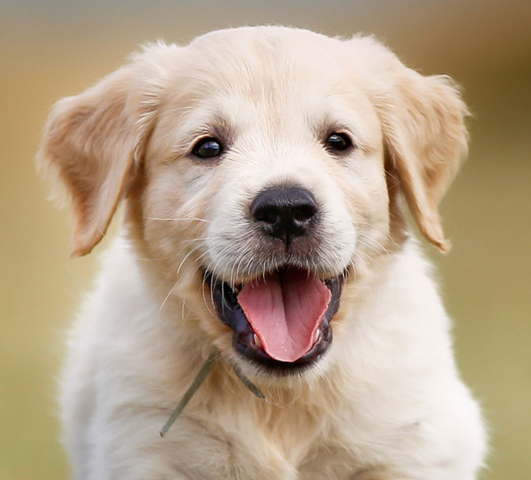
Basic dnn
.6
.1
.2
.1
Notes:
DNN/transfer learning background

Slide 12
Training a DNN
Notes:
DNN/transfer learning background

Slide 13
Training a DNN
Notes:
DNN/transfer learning background

Slide 14
Training a DNN
Notes:
DNN/transfer learning background

Slide 15
Fine-tuning dnn #1
Notes:
DNN/transfer learning background
There are common, industry standard models to use, that facilitate sharing

Slide 16
Fine-tuning dnn #1
Notes:
DNN/transfer learning background

Slide 17
Fine-tuning dnn #1
Notes:
DNN/transfer learning background

Slide 18
Fine-tuning dnn #1
Notes:
DNN/transfer learning background

Slide 19
Fine-tuning dnn #2
Notes:
DNN/transfer learning background

Slide 20
Two dnns as run in mainstream
Notes:
And you don’t know if that there’s similarities between with them. Did all of the red stuff twice. Base piece of our opportuniy. REd stuff doesn’t have to be done twicwe
Because the output of the red stuff is gonna be identical. Animate in merged DNNed. Number of bubbles you have to process are smaller, and if you have milions of bubbldes but hundreds of thousands of red bubbles

Slide 21
Mainstream takeaways
1
Merge video stream processing of concurrent apps
by sharing redundant computation
2
Dynamically tune degree of specialization at runtime
based on resources available and deployed apps
1
Up to 87x improvement in F1-score
compared to No Sharing
2
Up to 47% improvement in F1-score
compared to Max Sharing

Slide 22
Mainstream takeaways
1
Merge video stream processing of concurrent apps
by sharing redundant computation
2
Dynamically tune degree of specialization at runtime
based on resources available and deployed apps
1
Up to 87x improvement in F1-score
compared to No Sharing
2
Up to 47% improvement in F1-score
compared to Max Sharing

Slide 23
Performance trade-offs from specialization

Slide 24
More sharing = Higher throughput
More specialization = Higher per-frame acc.

Slide 25
How do we measure application performance?

Slide 26
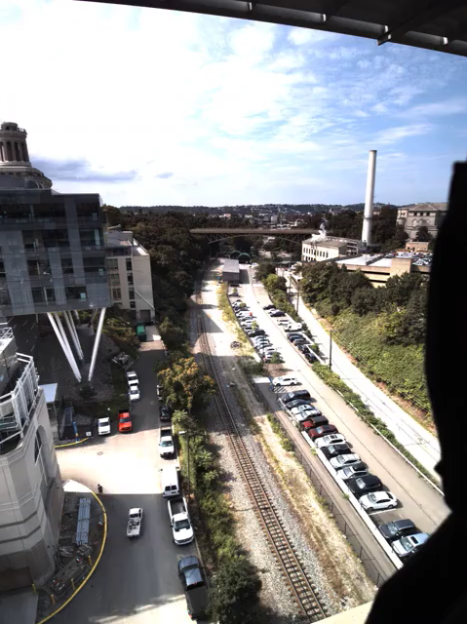
Application example:
Event detection
Notes:
Grey out
Hammer on *front* of the train, so needs to be one of the two

Slide 27
Goal: maximize event f1-score
Event-Recall How many relevant events are detected?
Event-Precision How many detected events are relevant?
Event-F1 score Harmonic mean between precision and recall
Notes:
Precision -> opposite of FNR

Slide 28
Effect of accuracy and fps on f1-score

Slide 29
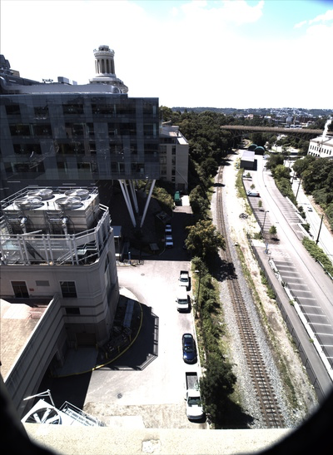
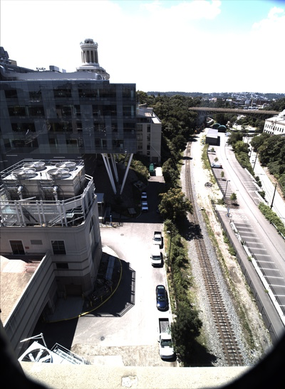
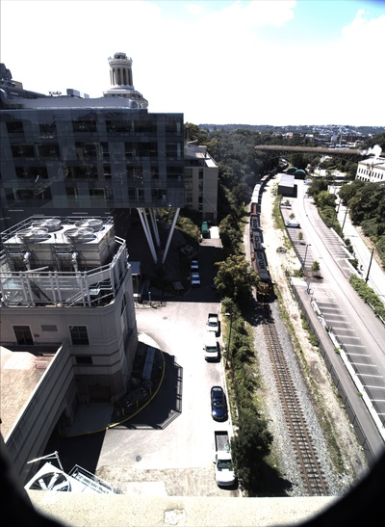
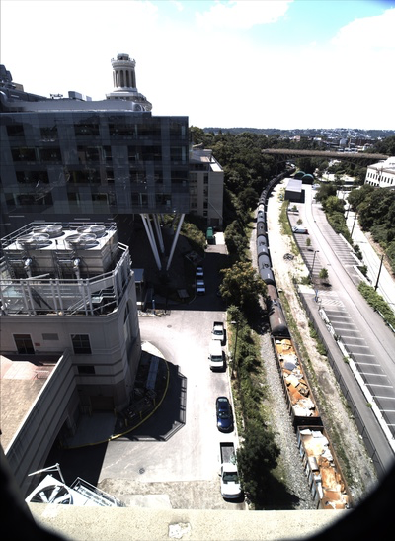
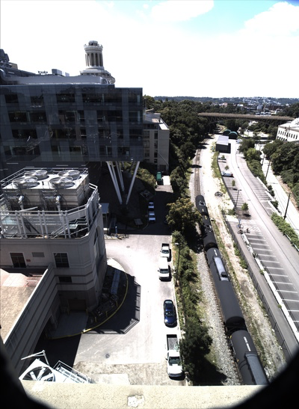
Notes:
Grey out
Hammer on *front* of the train, so needs to be one of the two

Slide 30
Notes:
Grey out
Hammer on *front* of the train, so needs to be one of the two

Slide 31
Notes:
Grey out
Hammer on *front* of the train, so needs to be one of the two

Slide 32
Notes:
Grey out
Hammer on *front* of the train, so needs to be one of the two

Slide 33
Notes:
Grey out
Hammer on *front* of the train, so needs to be one of the two

Slide 34
Mainstream architecture

Slide 35
Mainstream architecture
1
2
4
5
3

Slide 36
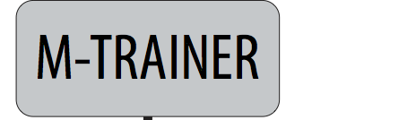
Decentralized, sharing-aware training
% specialized | Top1 Acc. | Model
Minimum event length = 50ms
Inter-frame correlation = 0.8
Notes:
In Mainstream training does not require centralized control of the data or training process
Each M-trainer is run locally by the app developer
It helps the app developer create and save the necessary information for scheduler to determine the amount of specialization at runtime
In particular, M-trainer creates model sets. So, instead of training one model, it trains multiple model candidates, each with a different amount of specialization (aka sharing potential)
It also saves important metadata
Most importantly, our model sets allow the late binding of how much specialization is used at runtime
And M-Trainers can be run independently and at different times by the application developer

Slide 37
Mainstream results

Slide 38
Mainstream takeaways
1
Merge video stream processing of concurrent apps
by sharing redundant computation
2
Dynamically tune degree of specialization at runtime
based on resources available and deployed apps
1
Up to 87x improvement in F1-score
compared to No Sharing
2
Up to 47% improvement in F1-score
compared to Max Sharing

Slide 39
Experimental setup
Run concurrent image classification pipelines
Using MobileNet-224 DNNs
Tasks: Pedestrian, Bus, Red Car, Scramble, Schoolbus, Trains, Car
Hardware: Desktop-class computer
Video stream: 20FPS, 640x480
Decode
Transform
Classify
Post-process

Slide 40
Mainstream improves event f1-score by 87x
Notes:
We compare against 2 static approaches
No sharing is one end of the extreme where we deploy a full DNN for every applications
Max sharing conservatively shares all but the last layer
No sharing performs well when resources aren’t constrainted and it’s able to run its fully-specialized networks at a high enough frame rate
No Sharing’s frame-rate degrades quickly and it soon begins to miss events
Max sharing is able to scale a lot better, but often underutilizes resources, never achieving a high model accuracy

Slide 41
Mainstream improves event f1-score by 87x
Frame rel acc: 1
2.3 FPS
Notes:
We compare against 2 static approaches
No sharing is one end of the extreme where we deploy a full DNN for every applications
Max sharing conservatively shares all but the last layer
No sharing performs well when resources aren’t constrainted and it’s able to run its fully-specialized networks at a high enough frame rate
No Sharing’s frame-rate degrades quickly and it soon begins to miss events
Max sharing is able to scale a lot better, but often underutilizes resources, never achieving a high model accuracy

Slide 42
Mainstream improves event f1-score by 87x
Frame rel acc: 1
0.36 FPS
Notes:
We compare against 2 static approaches
No sharing is one end of the extreme where we deploy a full DNN for every applications
Max sharing conservatively shares all but the last layer
No sharing performs well when resources aren’t constrainted and it’s able to run its fully-specialized networks at a high enough frame rate
No Sharing’s frame-rate degrades quickly and it soon begins to miss events
Max sharing is able to scale a lot better, but often underutilizes resources, never achieving a high model accuracy

Slide 43
Mainstream improves event f1-score by 87x
Frame rel acc: .59
6.8 FPS
Notes:
We compare against 2 static approaches
No sharing is one end of the extreme where we deploy a full DNN for every applications
Max sharing conservatively shares all but the last layer
No sharing performs well when resources aren’t constrainted and it’s able to run its fully-specialized networks at a high enough frame rate
No Sharing’s frame-rate degrades quickly and it soon begins to miss events
Max sharing is able to scale a lot better, but often underutilizes resources, never achieving a high model accuracy

Slide 44
Mainstream improves event f1-score by 87x
Frame rel acc: .59
6.8 FPS
Notes:
We compare against 2 static approaches
No sharing is one end of the extreme where we deploy a full DNN for every applications
Max sharing conservatively shares all but the last layer
No sharing performs well when resources aren’t constrainted and it’s able to run its fully-specialized networks at a high enough frame rate
No Sharing’s frame-rate degrades quickly and it soon begins to miss events
Max sharing is able to scale a lot better, but often underutilizes resources, never achieving a high model accuracy

Slide 45
Mainstream improves event f1-score by 87x
Frame rel acc: 0.96
5.9 FPS
Notes:
We compare against 2 static approaches
No sharing is one end of the extreme where we deploy a full DNN for every applications
Max sharing conservatively shares all but the last layer
No sharing performs well when resources aren’t constrainted and it’s able to run its fully-specialized networks at a high enough frame rate
No Sharing’s frame-rate degrades quickly and it soon begins to miss events
Max sharing is able to scale a lot better, but often underutilizes resources, never achieving a high model accuracy

Slide 46
Mainstream improves event f1-score by 87x
Frame rel acc: 0.9
5.6 FPS
Notes:
We compare against 2 static approaches
No sharing is one end of the extreme where we deploy a full DNN for every applications
Max sharing conservatively shares all but the last layer
No sharing performs well when resources aren’t constrainted and it’s able to run its fully-specialized networks at a high enough frame rate
No Sharing’s frame-rate degrades quickly and it soon begins to miss events
Max sharing is able to scale a lot better, but often underutilizes resources, never achieving a high model accuracy

Slide 47
Mainstream takeaways
1
Merge video stream processing of concurrent apps
by sharing redundant computation
2
Dynamically tune degree of specialization at runtime
based on resources available and deployed apps
1
Up to 87x improvement in F1-score
compared to No Sharing
2
Up to 47% improvement in F1-score
compared to Max Sharing

Slide 48
Thank you!

Slide 49
Backup slides

Slide 50
Experimental setup
Run concurrent image classification pipelines
Performed with InceptionV3 and MobileNet-224 DNNs
Hardware: Desktop-class computer
Video stream: 20FPS, 640x480
Decode
Transform
Classify
Post-process

Slide 51
Less specialized ➝ faster processing
Running image classifiers with InceptionV3
Notes:
Build this
Talk about red line first and more
That change dramatically as soon as we add one more app

Slide 52
Less specialized ➝ lower per-frame acc

Slide 53
Estimating application quality
Notes:
Precision -> opposite of FNR

Slide 54
Estimating application quality
Notes:
What you say for the first frame is the same as what you’ll say for the second frame

Slide 55
Estimating application quality
Notes:
Precision -> opposite of FNR

